Slide 1
Secure Data Hiding in Image Using Steganography
CAPSTONE PROJECT
Presented By:
Student Name :Belli Geetha Bhavani
College Name & Department : KL University & CSE

Slide 2
OUTLINE
Problem Statement
Technology used
Wow factor
End users
Result
Conclusion
Git-hub Link
Future scope

Slide 3
Problem Statement
With the increasing need for secure communication, traditional encryption methods alone may not be sufficient to protect sensitive information from attackers. Steganography, the practice of concealing data within digital media, offers an additional layer of security by hiding information in images in such a way that it remains undetectable to unauthorized users. However, existing steganographic techniques often face challenges such as low embedding capacity, vulnerability to steganalysis, and degradation of image quality.
This project aims to develop a secure and efficient image steganography technique that ensures high imperceptibility, robustness against attacks, and optimized data hiding capacity. The proposed solution will utilize advanced encoding methods and encryption mechanisms to enhance security while maintaining the visual integrity of the carrier image.

Slide 4
Technology used
Libraries:
OpenCV (cv2) – Used for image processing, including reading and writing images.
OS (os) – Used for system-level operations, such as opening the encrypted image.
String (string) – Although imported, it is not used in the code.
Platform:
The code is designed to run on Windows OS due to the os.system("start encryptedImage.jpg") command.
Programming Language:
Python 3.x – The code is written in Python, using basic dictionaries and loops for encoding and decoding the message.
Concept Used:
Image Steganography – The program hides a secret message inside an image by modifying pixel values.
Basic Encryption – A passcode is used to restrict access to the hidden message.

Slide 5
Wow factors
Passcode-Protected Decryption
Unlike many steganography projects that only hide data, this project requires a correct passcode to decrypt the message, adding an extra layer of security.
Minimal Image Distortion
Instead of modifying the least significant bit (LSB) of each pixel, the project directly maps ASCII values, ensuring that the changes are less noticeable and preserving the image's overall quality.
Lightweight & No External Dependencies
The project only requires OpenCV and standard Python libraries, making it lightweight and easy to run without installing additional cryptographic or image-processing libraries.
Fully Reversible & Simple to Implement
The encryption and decryption process is fully reversible without needing external metadata or files, making it an easy-to-understand and beginner-friendly steganography approach.

Slide 6
End users
Cybersecurity Enthusiasts & Ethical Hackers
Individuals interested in data hiding techniques and steganography-based security research can use this project to understand how secret messages can be embedded in images.
Students & Researchers
Ideal for computer science students, cybersecurity learners, and academic researchers who want to study or demonstrate steganography concepts in an easy and practical way.
Intelligence & Law Enforcement Agencies
Can be adapted for covert communication or forensic analysis to detect hidden messages in digital media.
Secure Communication Users
Journalists, activists, and individuals working in high-risk environments can use it to discreetly send sensitive messages without attracting attention.

Slide 7
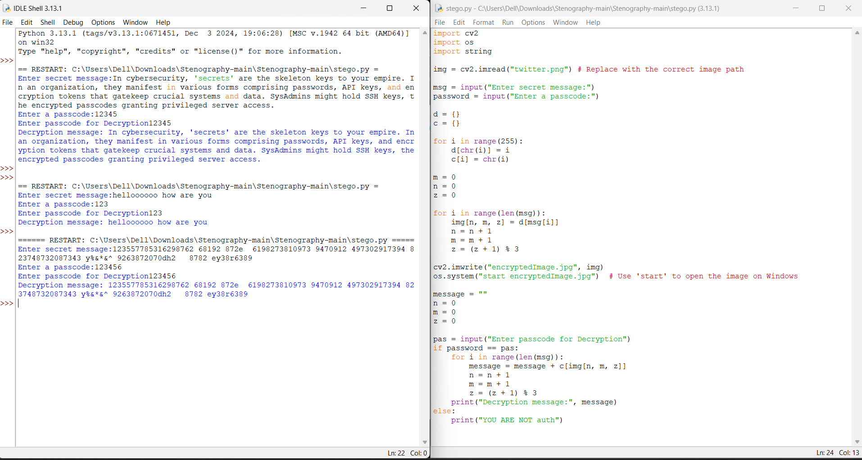

Results

Slide 8
Conclusion
This project successfully addresses the need for secure and discreet communication by implementing image steganography with passcode-protected decryption. Unlike traditional encryption, which may attract attention, this method allows users to hide sensitive messages within images, making the data practically invisible to unauthorized parties.
By modifying pixel values directly and keeping the image distortion minimal, the project ensures that the hidden message remains undetectable while preserving the image’s visual integrity. Additionally, the lightweight implementation using OpenCV makes it accessible for students, researchers, and cybersecurity professionals looking for a simple yet effective steganographic technique.
Moving forward, this project can be enhanced by incorporating encryption mechanisms, adaptive embedding strategies, and resistance to steganalysis, making it even more secure for real-world applications.

Slide 9
GitHub Link
https://github.com/Belligeethabhavani/stegnograpy-aicte-project.git

Slide 10
Future scope(optional)
Advanced Steganography Techniques – Implement deep learning-based steganography for higher security.
Multi-Format Support – Extend support to other media types like audio and video steganography.
Cloud-Based Secure Communication – Develop a cloud-based steganography system for secure online communication.

Slide 11
THANK YOU

